Slide 1
Campus Shuttle
Bus Simulation
Simulation focus
01
Reproduce the morning bus queue
How bus frequency changes
queue length and waiting time
02
Model uncertainty in arrivals and operations
03
Compare bus_interval = 4, 5, and 6 min
MATLAB implementation: main.m / run_single_simulation.m / plot_simulation_results.m
Monte Carlo simulation • 10,000 runs
Notes:
Good morning, everyone. Welcome to our presentation on the Campus ShuttleBus Simulation. Today, we are going to walk you through our study on how changing bus dispatch frequency directly impacts student queue lengths and waiting times during morning rush hours. This project was developed using a 10,000-run Monte Carlo simulation in MATLAB.

Slide 2
1. Simulation Overview
Morning shuttle queue from 7:00 to 10:00
INPUT
STATE
OUTPUT
Train arrivals
Bus queue
Bus service
Students arrive in groups according to the train timetable.
Non-walking students join a FIFO queue with their arrival times stored.
Buses arrive with random delays and capacities, then board students.
Key assumptions
1 minute per slot
Train-based group arrivals
10% choose to walk
Bus capacity: 70–80
Bus delay: 0–5 min
The model tracks each student’s arrival minute, making both FIFO boarding and individual waiting-time calculation possible.
Notes:
To give you an overview of our model: we simulated the morning shuttle bus queue between 7:00 AM and 10:00 AM—a total 3-hour peak window modeled in 1-minute time steps.
1. Inputs: Students arrive in batches at the campus station according to actual train schedules.
2. State: Students who choose not to walk enter a First-In, First-Out (FIFO) queue with their exact arrival time recorded.
3. Outputs: Shuttle buses arrive with random operational delays and variable seating capacities to pick up waiting passengers.
4. Key Parameters: We assume 10% of arriving students choose to walk to campus, bus capacity fluctuates between 70 and 80 passengers, and bus arrival delay ranges randomly from 0 to 5 minutes."

Slide 3
2. Three-File Architecture
Each file has one clear responsibility
01
02
03
main.m
run_single_simulation.m
plot_simulation_results.m
Experiment controller
Single-run engine
Visualization
Sets schedules and parameters
Generates bus capacity and delay
Receives the mean queue history
Runs 10,000 simulations
Processes train and bus events
Plots average queue length over time
Aggregates means and standard deviations
Calculates waiting-time metrics
Keeps analysis and plotting separate
Notes:
Our MATLAB code is designed using a clean, modular three-file architecture where each file handles a single distinct responsibility:
1. main.m serves as the experiment controller. It sets timetables and parameters, executes all 10,000 Monte Carlo runs, and computes aggregated metrics like means and standard deviations.
2. run_single_simulation.m is the core simulation engine. It generates randomized bus capacities and traffic delays, processes event logs minute by minute, and tracks individual student waiting times.
3. plot_simulation_results.m is responsible purely for visualization, receiving the averaged queue history from main.m and producing our clear diagnostic plots.

Slide 4
3. How the Queue Is Reproduced
A student-level FIFO model
1
2
3
4
5
Train arrives
Walking choice
Join queue
Bus arrives
FIFO boarding
A group size is generated from a normal distribution.
Each student independently walks with probability 0.10.
Non-walking students are stored by arrival minute.
Capacity and delay vary in every simulation run.
Earliest arrivals board first; others remain.
student_arrivals = [arrival_time_1, arrival_time_2, arrival_time_3, ...]
Why this matters
The model measures average wait, maximum wait, queue peaks, transported students, and remaining students.
Wait time = bus arrival slot − student arrival slot
Notes:
Now let’s look at how the queue dynamics are reproduced at an individual student level:
1. When a train arrives, student group size is sampled from a normal distribution.
2. Each student independently decides whether to walk with a 10% probability.
3. Non-walking students join a FIFO queue where their arrival slot is logged.
4. When a bus arrives, its available capacity and arrival delay are randomly determined for that specific run.
5. Passengers board on a strict First-In, First-Out basis. A student’s individual wait time is calculated simply as the boarding bus slot minus their initial queue arrival slot.

Slide 5
4. Monte Carlo Simulation
Why the same morning is simulated 10,000 times
Random elements in one run
Run 1
Run 2
Run 10,000
Student arrivals
Normal distribution
Walking choice
10% probability
Bus capacity
70–80 students
Average across all runs
Stable estimate of queue length and performance metrics
Bus delay
0–5 minutes
rng(1) fixes the random-number sequence, so comparisons are reproducible.
One simulation may be unusually good or bad. Repetition reveals the typical system behavior.
Notes:
Why did we simulate the same morning 10,000 times?
A single simulation run can be overly optimistic or pessimistic due to random variance—such as a sudden burst of train arrivals or consecutive bus delays. By running 10,000 repetitions, extreme outliers cancel out, revealing the true expected behavior of the system.
Furthermore, by executing rng(1) at the beginning, we lock the pseudo-random number generator sequence. This guarantees that all comparisons between different bus frequencies are strictly controlled and reproducible.

Slide 6
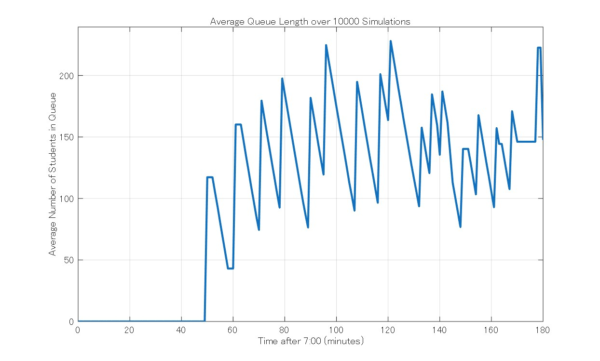
5. Baseline Result: bus_interval = 6 min
Average queue length over 10,000 simulations
Transported
Remaining
1,478.11
147.63
students
students
Average wait
Maximum wait
11.42
22.79
min
min
Maximum queue
270.52
students
At 6-minute intervals, the system cannot fully clear the morning demand by 10:00.
Notes:
Here are our baseline results when dispatching buses every 6 minutes:
Over 10,000 runs, an average of 1,478 students were transported. However, a significant queue of nearly 148 students remained waiting at 10:00 AM, meaning the system failed to clear morning demand.
The average student wait time was 11.42 minutes, with maximum wait times reaching 22.79 minutes, and peak queue length hitting 270 students. This proves that a 6-minute interval provides insufficient capacity for morning peak demand.

Slide 7
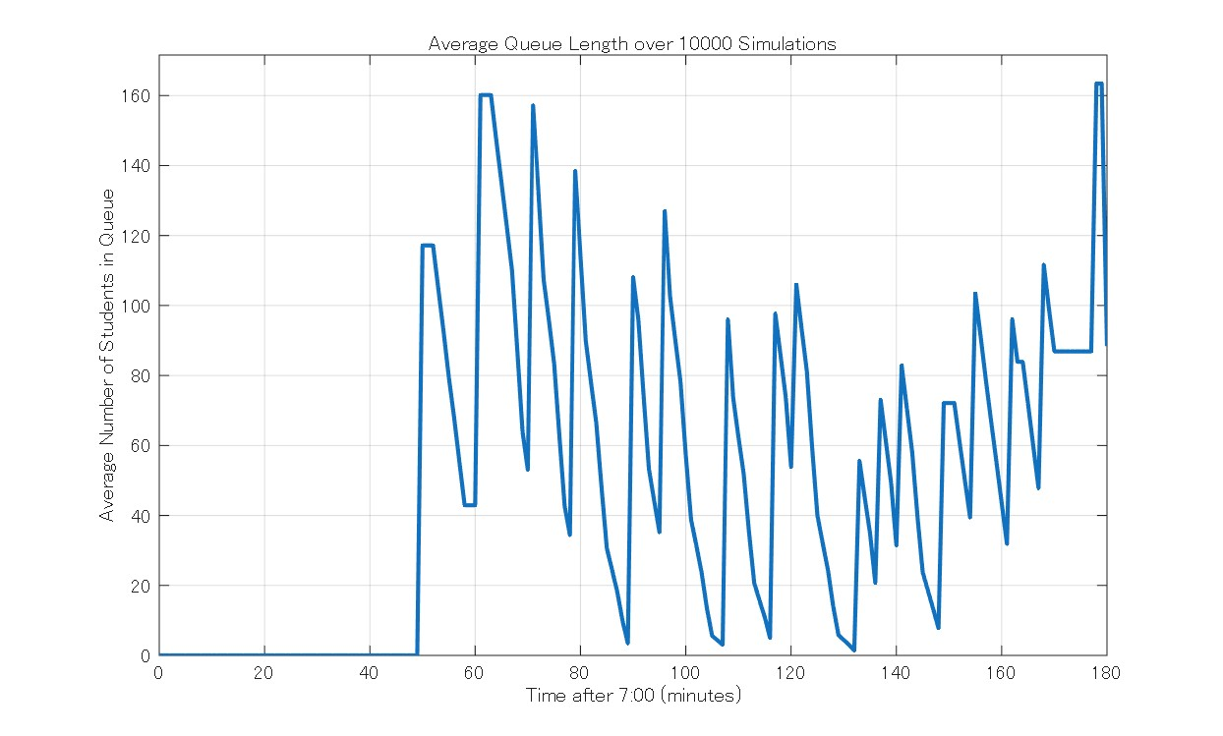
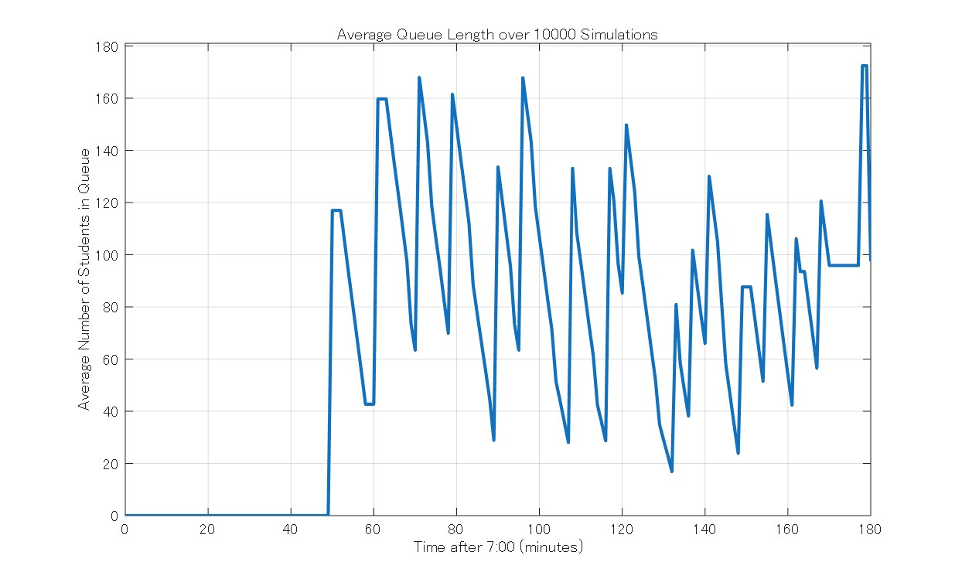
6. Effect of Changing bus_interval
Shorter intervals reduce congestion and waiting time
4 min
5 min
6 min
Metric
4 min
5 min
6 min
Transported students
1,536.21
1,527.38
1,478.11
Key finding
Remaining at 10:00
88.40
97.47
147.63
Changing 6 → 4 min cuts average waiting time by about 52% and reduces the maximum queue by about 26%.
Average wait (min)
5.47
7.39
11.42
Maximum wait (min)
17.93
18.60
22.79
Maximum queue
200.67
219.72
270.52
Notes:
Next, we conducted a sensitivity analysis comparing 4-minute, 5-minute, and 6-minute bus dispatch headways:
1. Transported Students: Increased from 1,478 (at 6 min) to 1,536 (at 4 min).
2. Remaining Queue at 10:00: Decreased significantly from 147.6 down to 88.4.
3. Average Wait Time: Dropped dramatically from 11.42 minutes to 5.47 minutes—a 52% reduction!
4. Peak Queue Length: Cut down from 270.5 to 200.7 students—a 26% reduction.
This clearly illustrates that small changes in dispatch frequency yield major operational improvements.

Slide 8
7. Conclusion
Simulation supports data-driven bus scheduling
The queue was reproduced realistically
01
Train-based group arrivals, walking choice, FIFO boarding, random bus capacities, and random delays were included.
Final assignment Group-B
Bus interval strongly affects performance
BRUNO ZOMIGNANI PERCIANI
02
As the interval increased from 4 to 6 minutes, queue length and waiting time increased clearly.
AOI TSUNEOKA
RIN WAKAMATSU
Four-minute service performed best
03
It transported more students, left fewer students waiting, and produced the shortest average wait among the tested settings.
Notes:
In conclusion:
1. Our Monte Carlo simulation successfully modeled complex campus queue dynamics under real-world operational uncertainty.
2. Dispatch frequency is the single most critical factor in controlling queue buildup and passenger frustration.
3. Our Recommendation: Operating the campus shuttle at a 4-minute dispatch interval during morning rush hours provides the best performance, transporting more students, clearing queues faster, and cutting average wait times in half.
Thank you very much for your attention! We are happy to answer any questions.

